Slide 1
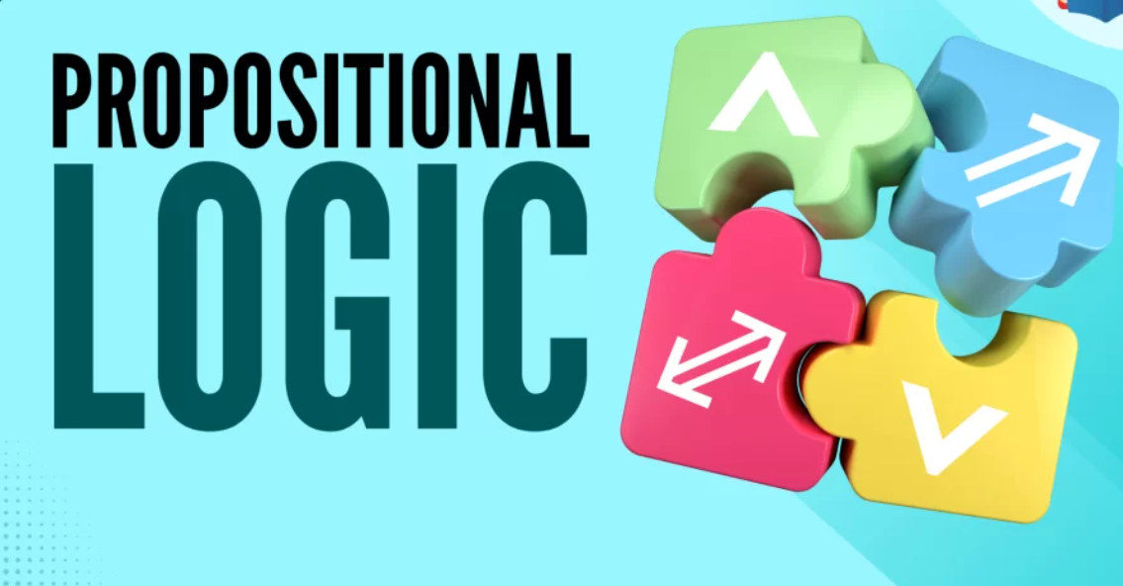
Propositional Logic

Slide 2
Course Outcome
Use suitable knowledge representation techniques for AI-based applications.
Session Learning Outcome:
Identify propositional statements and determine their truth values.
Represent simple and compound propositions using logical connectives and truth tables.
Apply propositional logic laws to analyze and simplify logical statements.

Slide 3
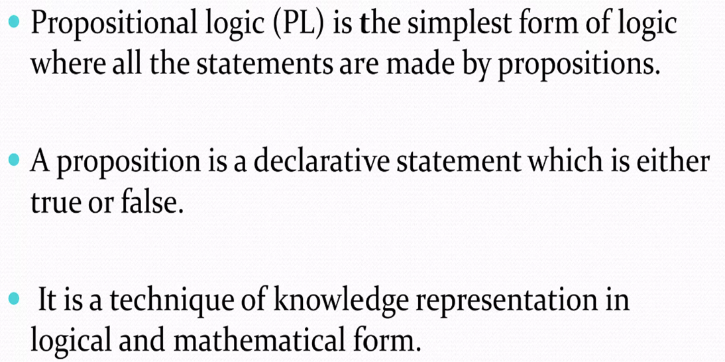

Propositional Logic
Notes:
Proposition - a statement or assertion that expresses a judgement or opinion:

Slide 4
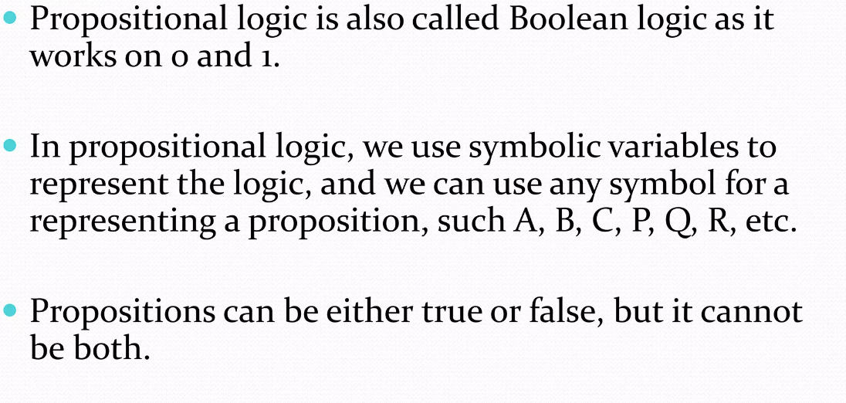
Propositional Logic

Slide 5
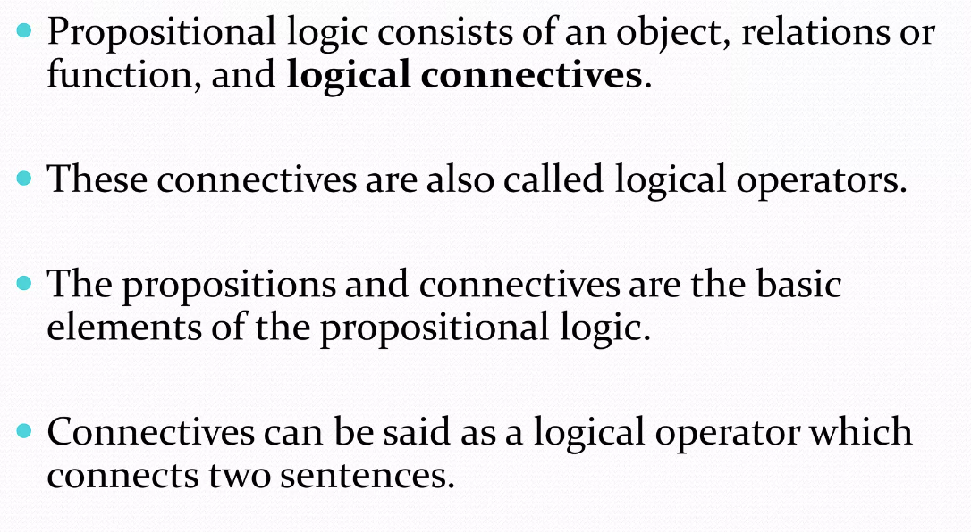
Propositional Logic

Slide 6
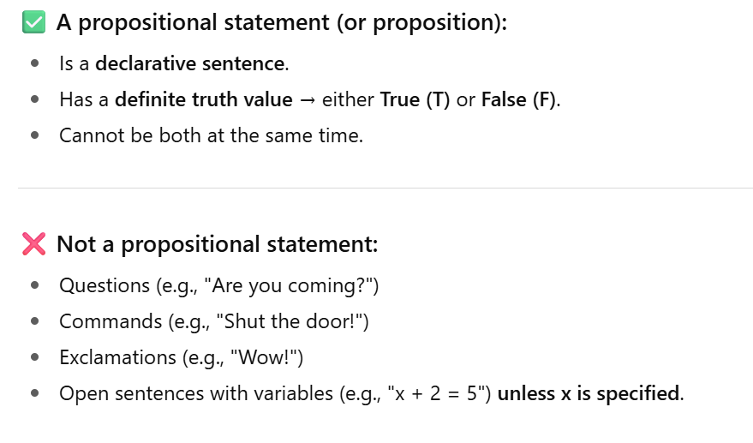
Propositional Logic

Slide 7
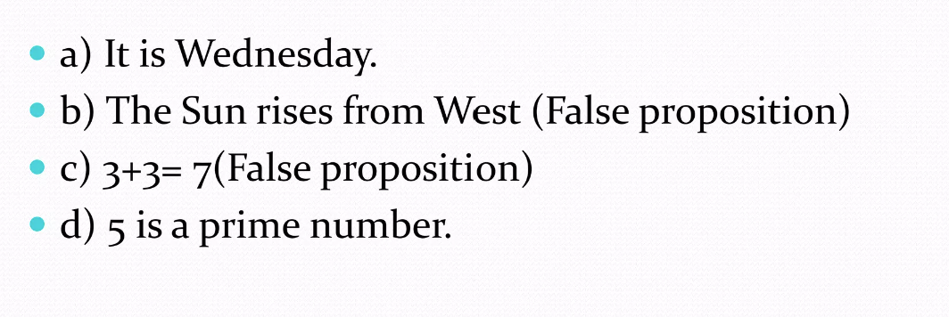
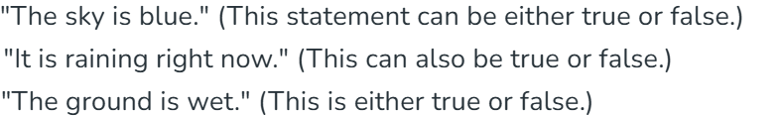
Example

Slide 8
Identify propositional statements.
The sun rises in the east.
Propositional (True).
2. Please switch off the fan.
Not propositional
3. 10 is a prime number.
Propositional (False)
4. Do you like chocolate?
Not propositional
5. All birds can fly.
Propositional (False)
6. 5 + 3 = 9.
Propositional (False)
7. x > 7.
Not propositional
8. The square root of 16 is 4.
Propositional (True)
9. Wow, that’s amazing!
Not propositional
10. Water boils at 100°C at sea level.
Propositional (True)

Slide 9
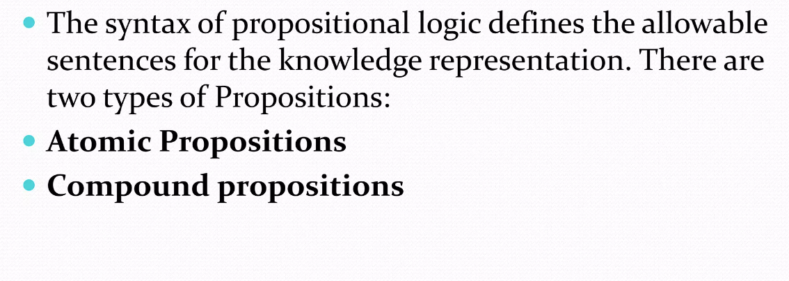
Syntax of Propositional Logic

Slide 10
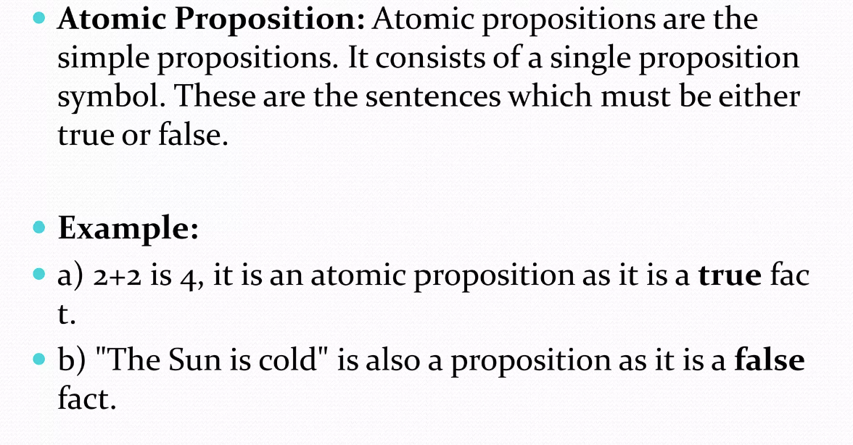
Atomic Proposition

Slide 11
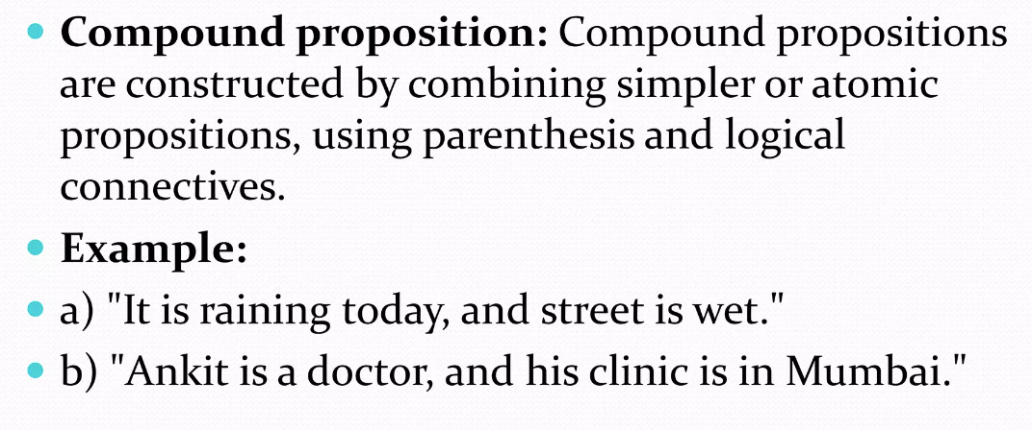
Compound Proposition

Slide 12
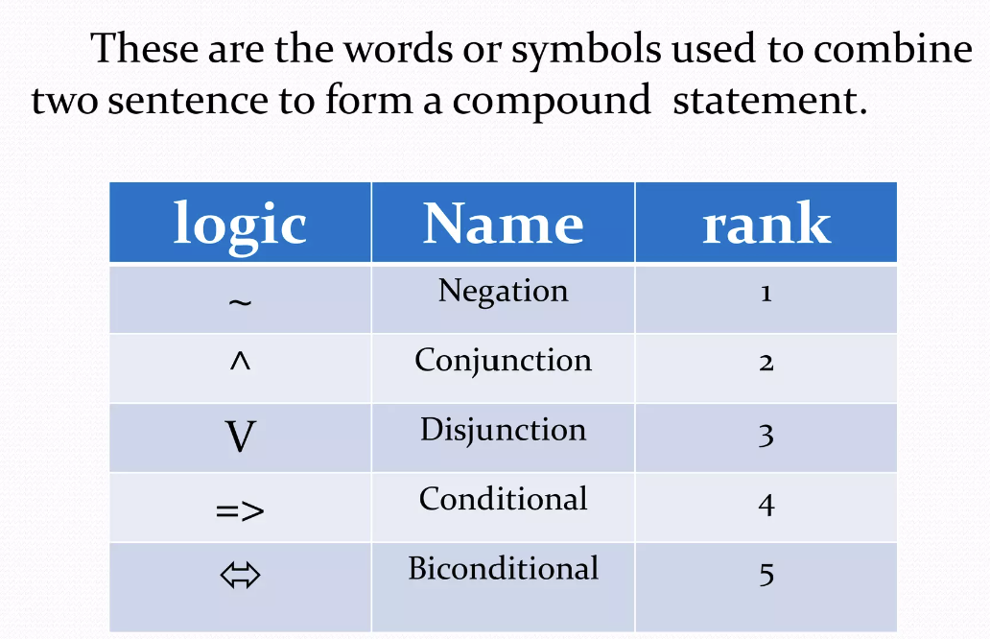
Compound Proposition

Slide 13
Classify whether atomic or compound
1. The Earth revolves around the Sun.
2. It is raining and it is windy.
3. If the switch is on, then the fan works.
4. 5 is an odd number.
5. Either the train is late or the bus is full.
6. Paris is the capital of France.
7. It is not true that 2 + 2 = 5.
8. The light is on if and only if the switch is pressed.
9. Water freezes at 0°C.
10. The exam is difficult but I will pass.

Slide 14
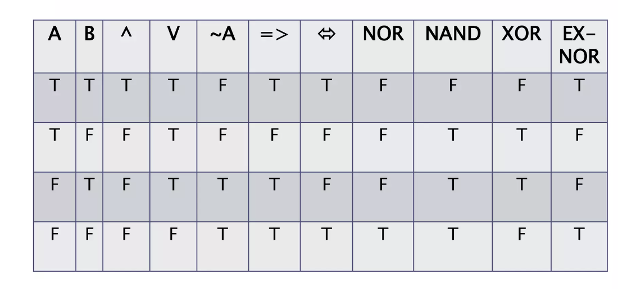
Basic Logical Operations

Slide 15
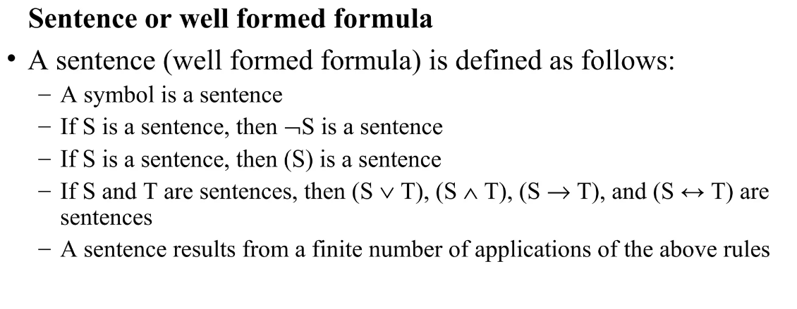

Slide 16
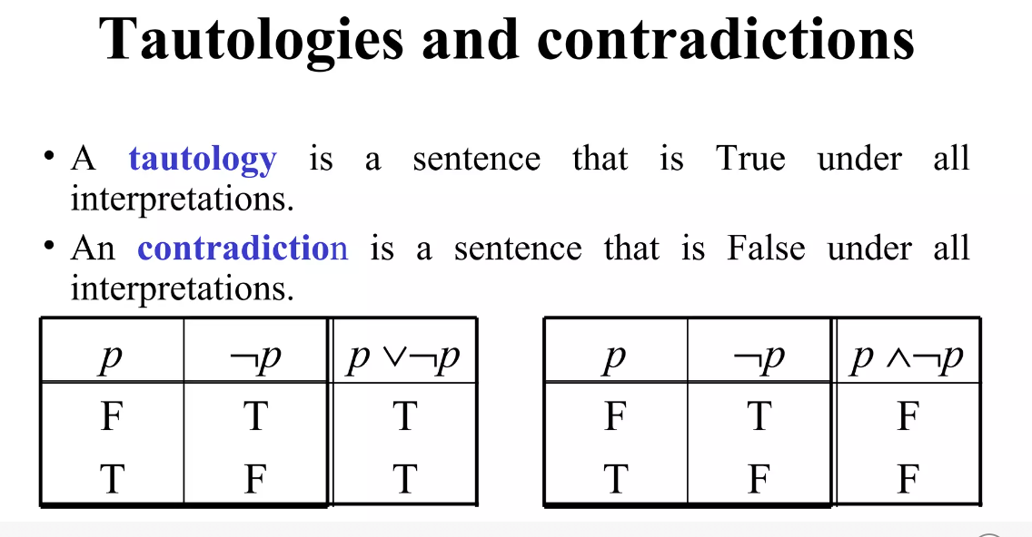
The light is on if and only if the switch is pressed.
Tautology
If it rains then the ground is wet, or if the ground is wet then it rains.
The light is switched on if and only if the switch is pressed.
Contradiction
If it rains then the ground is wet, and it rains but the ground is not wet.
The light is switched on and the switch is NOT pressed.

Slide 17
Contingent
A contingent statement (or contingency) is a propositional statement that is sometimes true and sometimes false, depending on the truth values of its components.
Example:
It is raining OR it is windy.
  True if it rains, or if it’s windy, or both.
  False only if neither is true.

Slide 18
Identify the following statements
It is day or it is night.
(Tautology)
It is both day and night at the same time.
(Contradiction)
If it is Sunday, then I have a holiday.
(Contingent)
I am both awake and asleep right now.
(Contradiction)
Either I pass the exam or I fail the exam.
(Tautology)
If I study, then I pass, OR if I do not study, then I fail.
(Contingent)

Slide 19
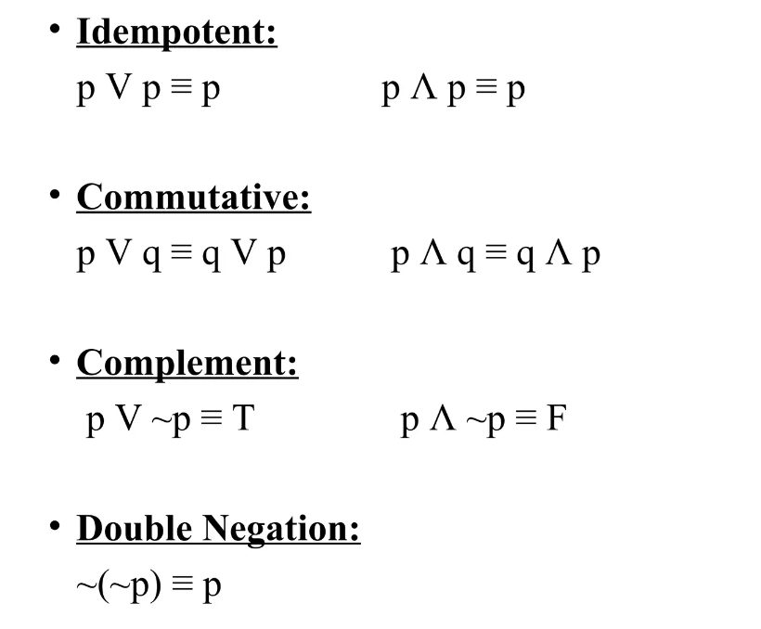
Laws of Algebra of Proposition

Slide 20
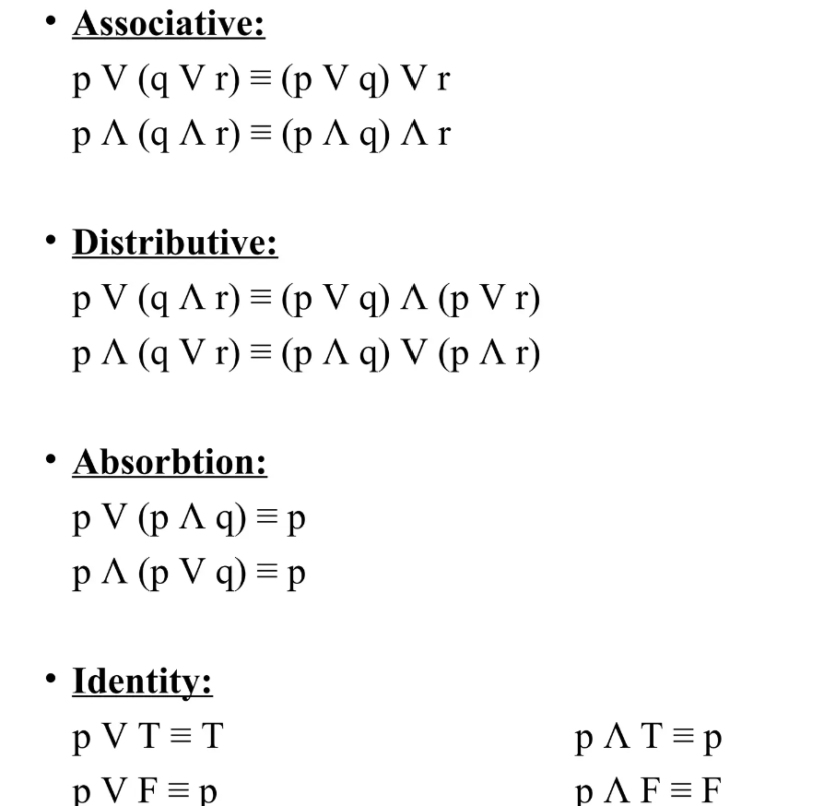
Laws of Algebra of Proposition

Slide 21
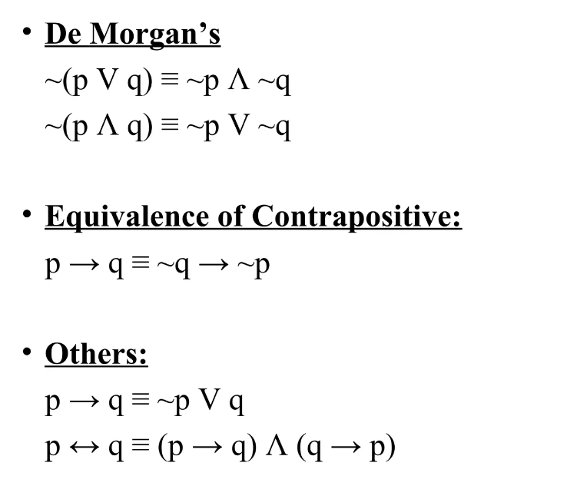
Laws of Algebra of Proposition

Slide 22
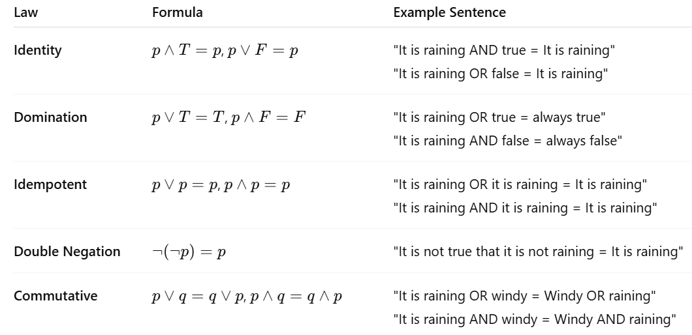
Laws of Boolean/Propositional Algebra (with Examples)

Slide 23
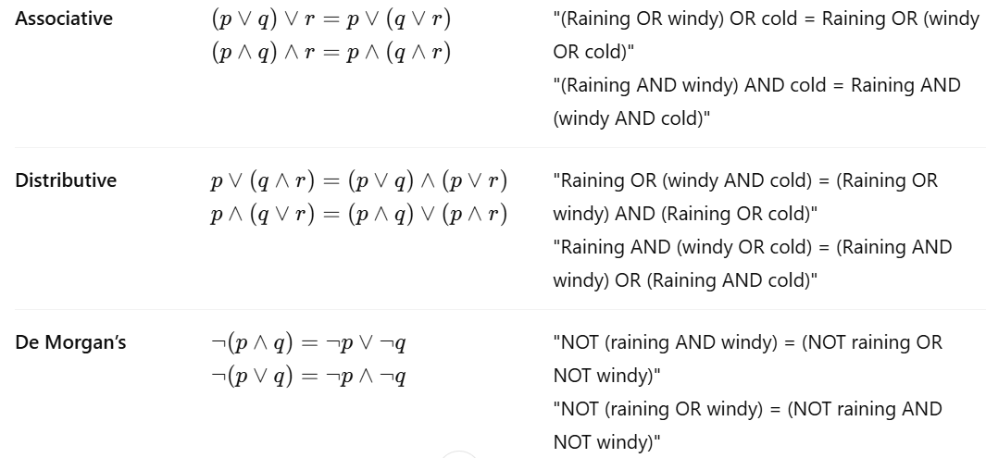
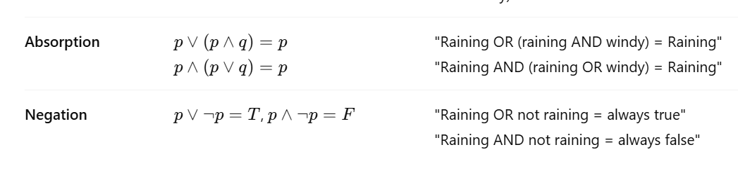
Laws of Boolean/Propositional Algebra (with Examples)

Slide 24
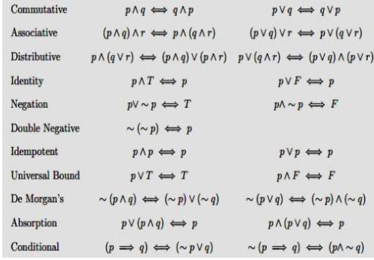
Summary of Laws of Algebra

